Slide 1
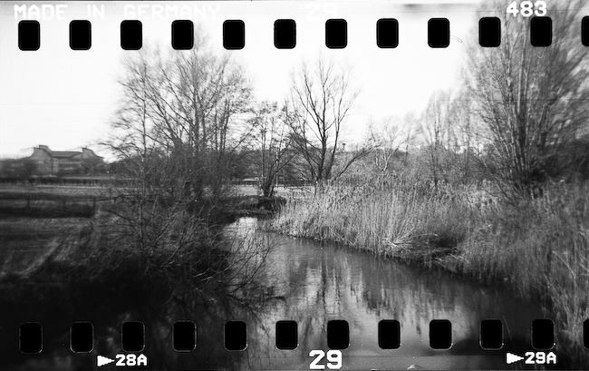
Bioinformatics at TSL
Notes:
Hello everyone! Today Im going to tell you all about the happenings in the Bioinformatics Team over the last year

Slide 2
Evolutionary Modeling
Training
Team
Bioinformatics
at TSL
Open
Science
Computational
Biology
Computational Biology
Fraxinus
Notes:
So heres the high level view of the things that go on in the team. Im going to pay attention to just a few of these things today.

Slide 3
Team
Notes:
The first thing I want to talk about briefly is the team itself.

Slide 4
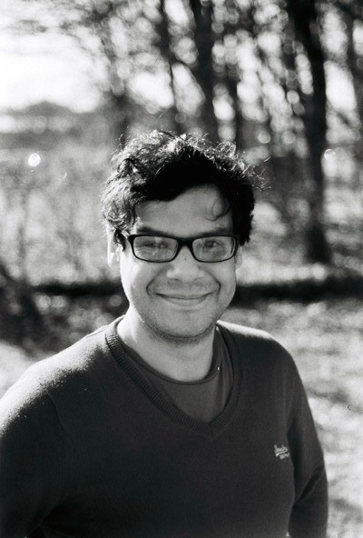
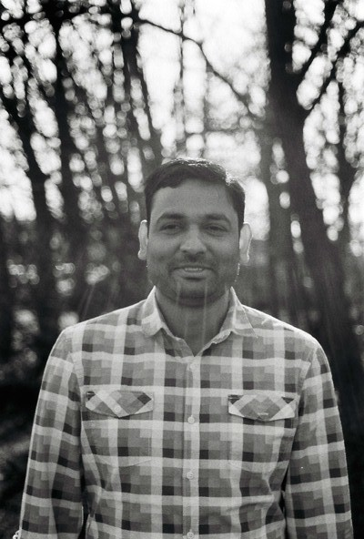
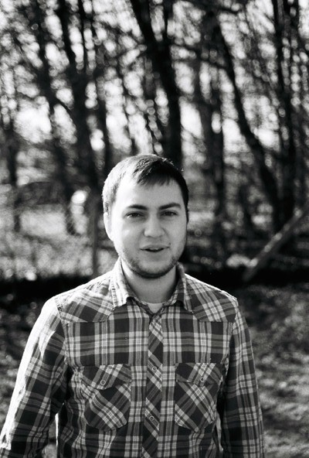
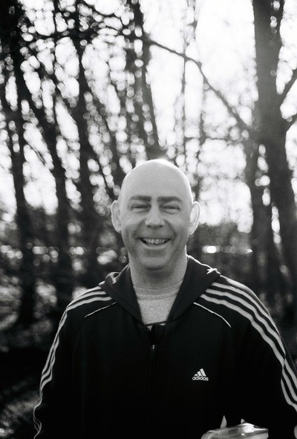

Notes:
So this is our motley crew, we have six members at the moment, some of them you may know, some of them you may not. But Im sure you’ll get to know and love just as much as I do very soon.
Of course we have Dr graham etherington.

Slide 5
Dr Graham
“That’s not a seagull”
Etherington
Support Officer
Galaxy Management
Methodological Training

Slide 6
Dr Shyam
“Tree Hugger”
Rallapalli
Fraxinus analysis
OADB curation

Slide 7
Ed
“Hendrix isn’t Dead”
Chalstrey
Algorithm Development

Slide 8
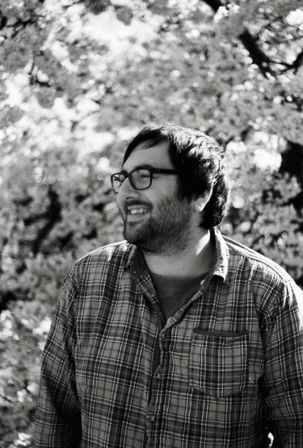
Martin
“Totes Amazeballs”
Page
Sys Admin
Cluster Feeding
Web Apps

Slide 9
Dr Carlos
“El Modelador”
Lugo
Theoretical Physicist
Evolutionary Models

Slide 10
Evolutionary Modeling
Training
Team
Bioinformatics
at TSL
Open
Science
Computational
Biology
Computational Biology
Fraxinus
Notes:
So that’s us, next up Id like to talk about one of our research projects that has involved a lot of our team and beyond

Slide 11
Open Ash
Dieback
Notes:
Im going to tell you about our work on providing bioinformatics and open science approaches for dealing with emergent pathogens, through the example of ash diebcak

Slide 12
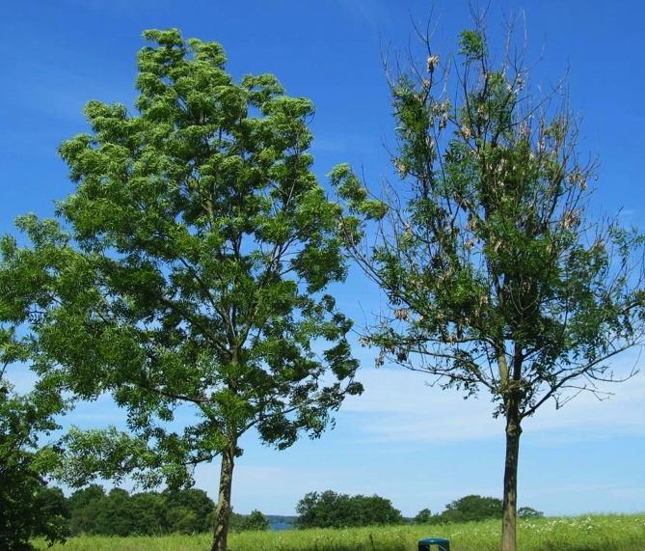
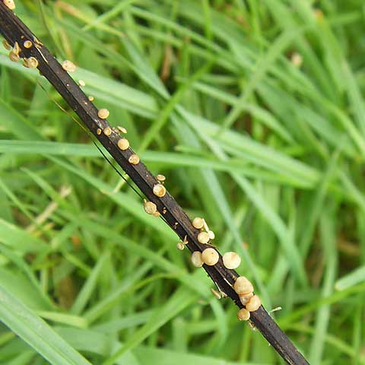
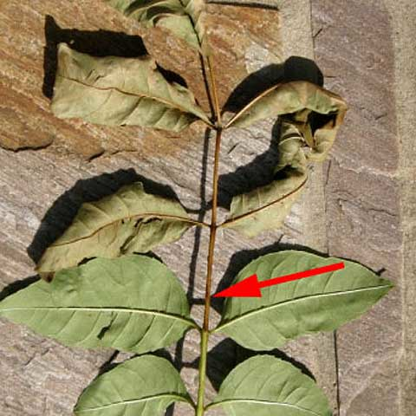
Notes:
Ash, or Fraxinus excelsior, is an important tree and has been so throughout history.
Ecologically Ash is vital, it’s a fast growing tree that crops up quickly in gaps in woodland and can support a massive range of biodiversity.
Ash lives to about 200 years old although when tended by coppicing practices it can live to be about 1000 years old. There are ash woods in norfolk dating back to the time of the vikings
This is what ash dieback looks like
Two roadside trees, The left tree is still looking unaffected this year whereas the right tree is now severely affected and producing many epicormic shoots, and the disease is even starting to affect the growth and the size of it’s crown.
Ash dieback is clearly noticeable as lesions and cankers on stems and branches, these are visible throughout year.
Throughout summer you can also see leaves with brown leaf stalks.
The causal pathogen makes fruiting bodies on fallen leaf stalks in spring.

Slide 13
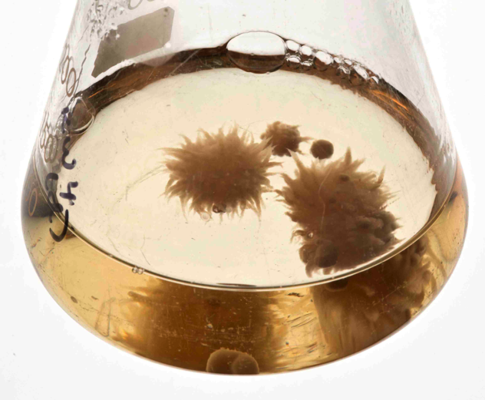
Hymenoscyphus pseudoalbidus
(Chalara fraxinea)
Notes:
The disease is caused by filamentous fungus (teleomorph) Hymenoscyphus pseudoalbidus
Its also called Chalara fraxinea, this is the name of the anamorph stage, lots of people call it chalara
The picutres are taken C. fraxinea growing in liquid media.
And when this was reported in the wild in the UK, it caught everyone a bit by surprise as it seemed to spread across the country really quickly and there was something of a national outcry that something must be done

Slide 14
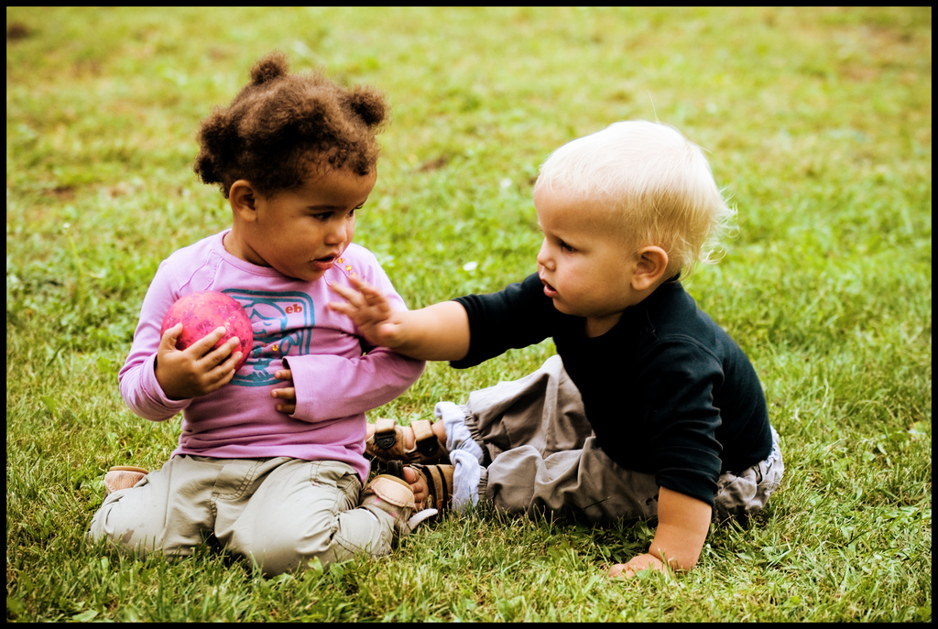
Science is too slow in emergencies
Structure of science inhibits sharing
Duo Penotti by Sabine75 on flickr, licensed under CC-BY 2.0
Notes:
Scientists have always been really bad at responding to a quick change in situations.
the usual business model we have as scientist is inhibitory to a joined up, fast response.
Normally we have to wait for funding of relatively isolated groups on specific projects and then,
because we are relying on high profile publications to get further funding we sit on results
and release data only when we’ve finished our own analyses and are ready to publish.
In situations where speed and collaboration is important this model provides too little, too late.

Slide 15
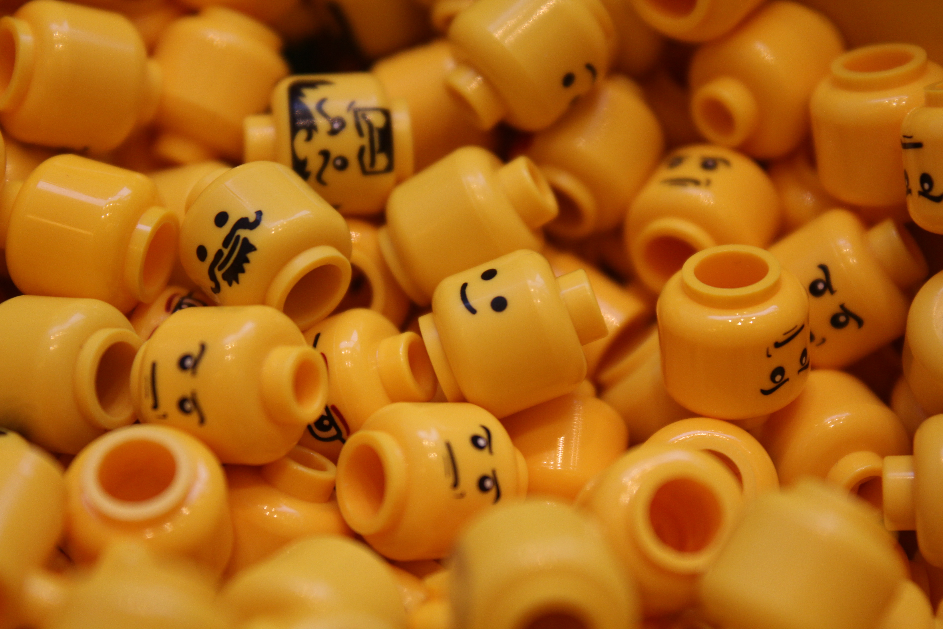
WE NEED NEW MODELS
“two heads are better than one”
Lego faces by Sunny Ripert on flickr, licensed under CC-BY-SA 2.0
Notes:
So we need new models.
And we work with the principal that two is better than one so to try and maximise the speed at which we can respond and to make the most of people and data power, with ash dieback we’ve applied a crowd-sourcing approach.
Crowdsourcing in our project is defined as the process whereby we make whatever data we can generate and can find instantly available, even before it is analysed, and let whoever can help, do what they can. Our initial crowd is scientists,
The practical upshot of this means valuable data gets to many more people who can deal with it much more quickly and more is learned quickly.

Slide 16
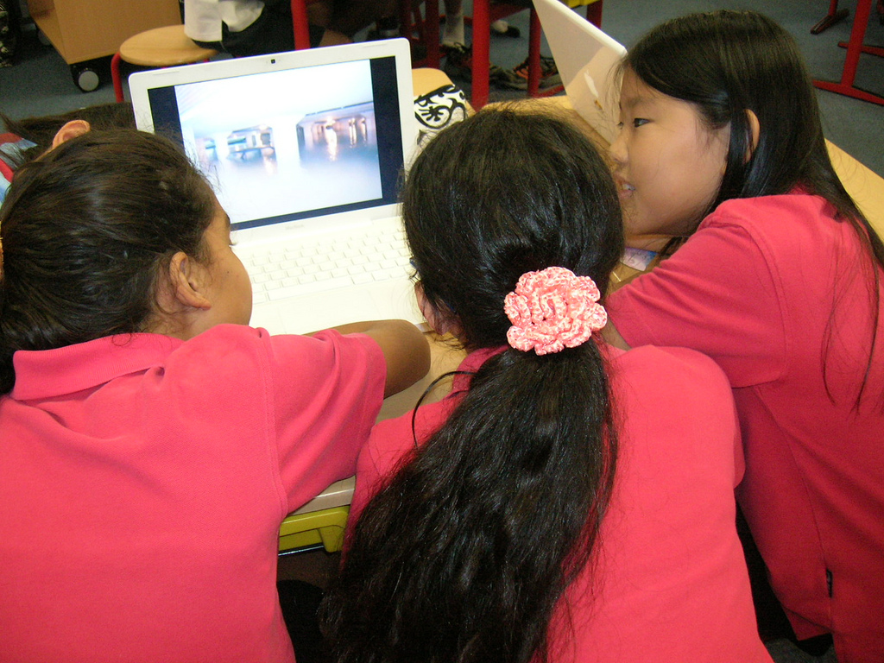
LIVE PEER REVIEW
a global on-line lab meeting
let the experts review the results as they appear – live filtering
PSA Peer Review by Room 202 on flickr, licensed under CC-BY-NC-SA 2.0
Notes:
A great advantage to this is that having a community closely watch the release of data and results as they appear means review and criticism and improvement can happen much more quickly.
Results are examined and filtered in a live peer review process
and with the internet we don’t need the traditional journals as primary data release anymore, so we can turn our way of working on its head and have a publish then filter model, which should allow us to progress much quicker as a community – by removing the incentive for groups to sit on their data until after its published

Slide 17
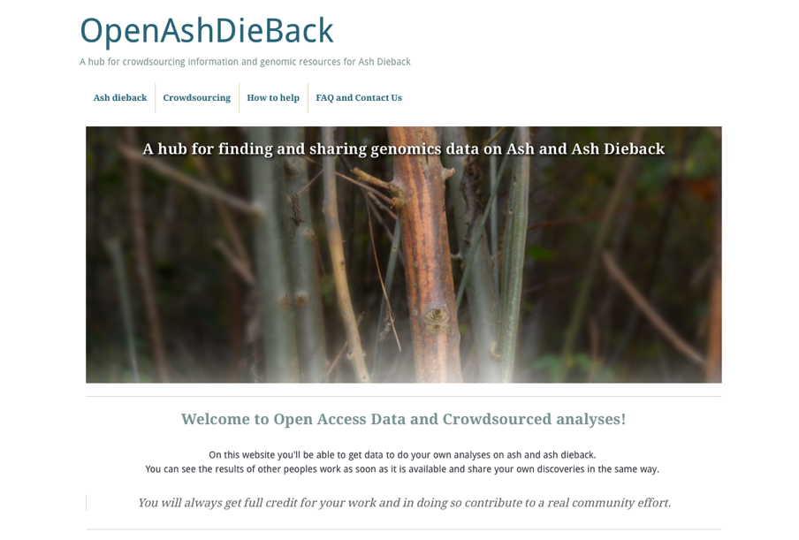
http://oadb.tsl.ac.uk
Notes:
So to embody this and fight back against Ash-dieback, a group of us have come together to bring Open Access data principles to try and fast-forward collaboration on genomics of ash and ash dieback.
We’ve put up a hub website to facilitate this, called OpenAshDieBack. Which is at this URL. This website contains links to our data repo and blog posts describing the analyses and data that people have contributed

Slide 18



ATTRIBUTION OF CONTRIBUTION
Git and GitHub as a versioned database
push
back
pull
data
make change
Notes:
The data and results themselves are actually hosted externally on the public website, github.
If you’re not familiar with github, it’s a peculiar sort of social networking site
Github is a programmers social coding website. Github is really great at tracking changes to files and keeping records of who made these changes.
The work cycle is really straightforward: you start the day by pulling the latest version of the data from github,
you make the changes/additions/new data that you think are appropriate and push it back.
Github sits in the middle keeping track of what changes were made and who made them.
That’s the key reason for using github, because its critical that we make proper attribution of contribution.
If we’re going to get people to give their time and effort for free, we really need to make sure that we’re giving credit for it.

Slide 19
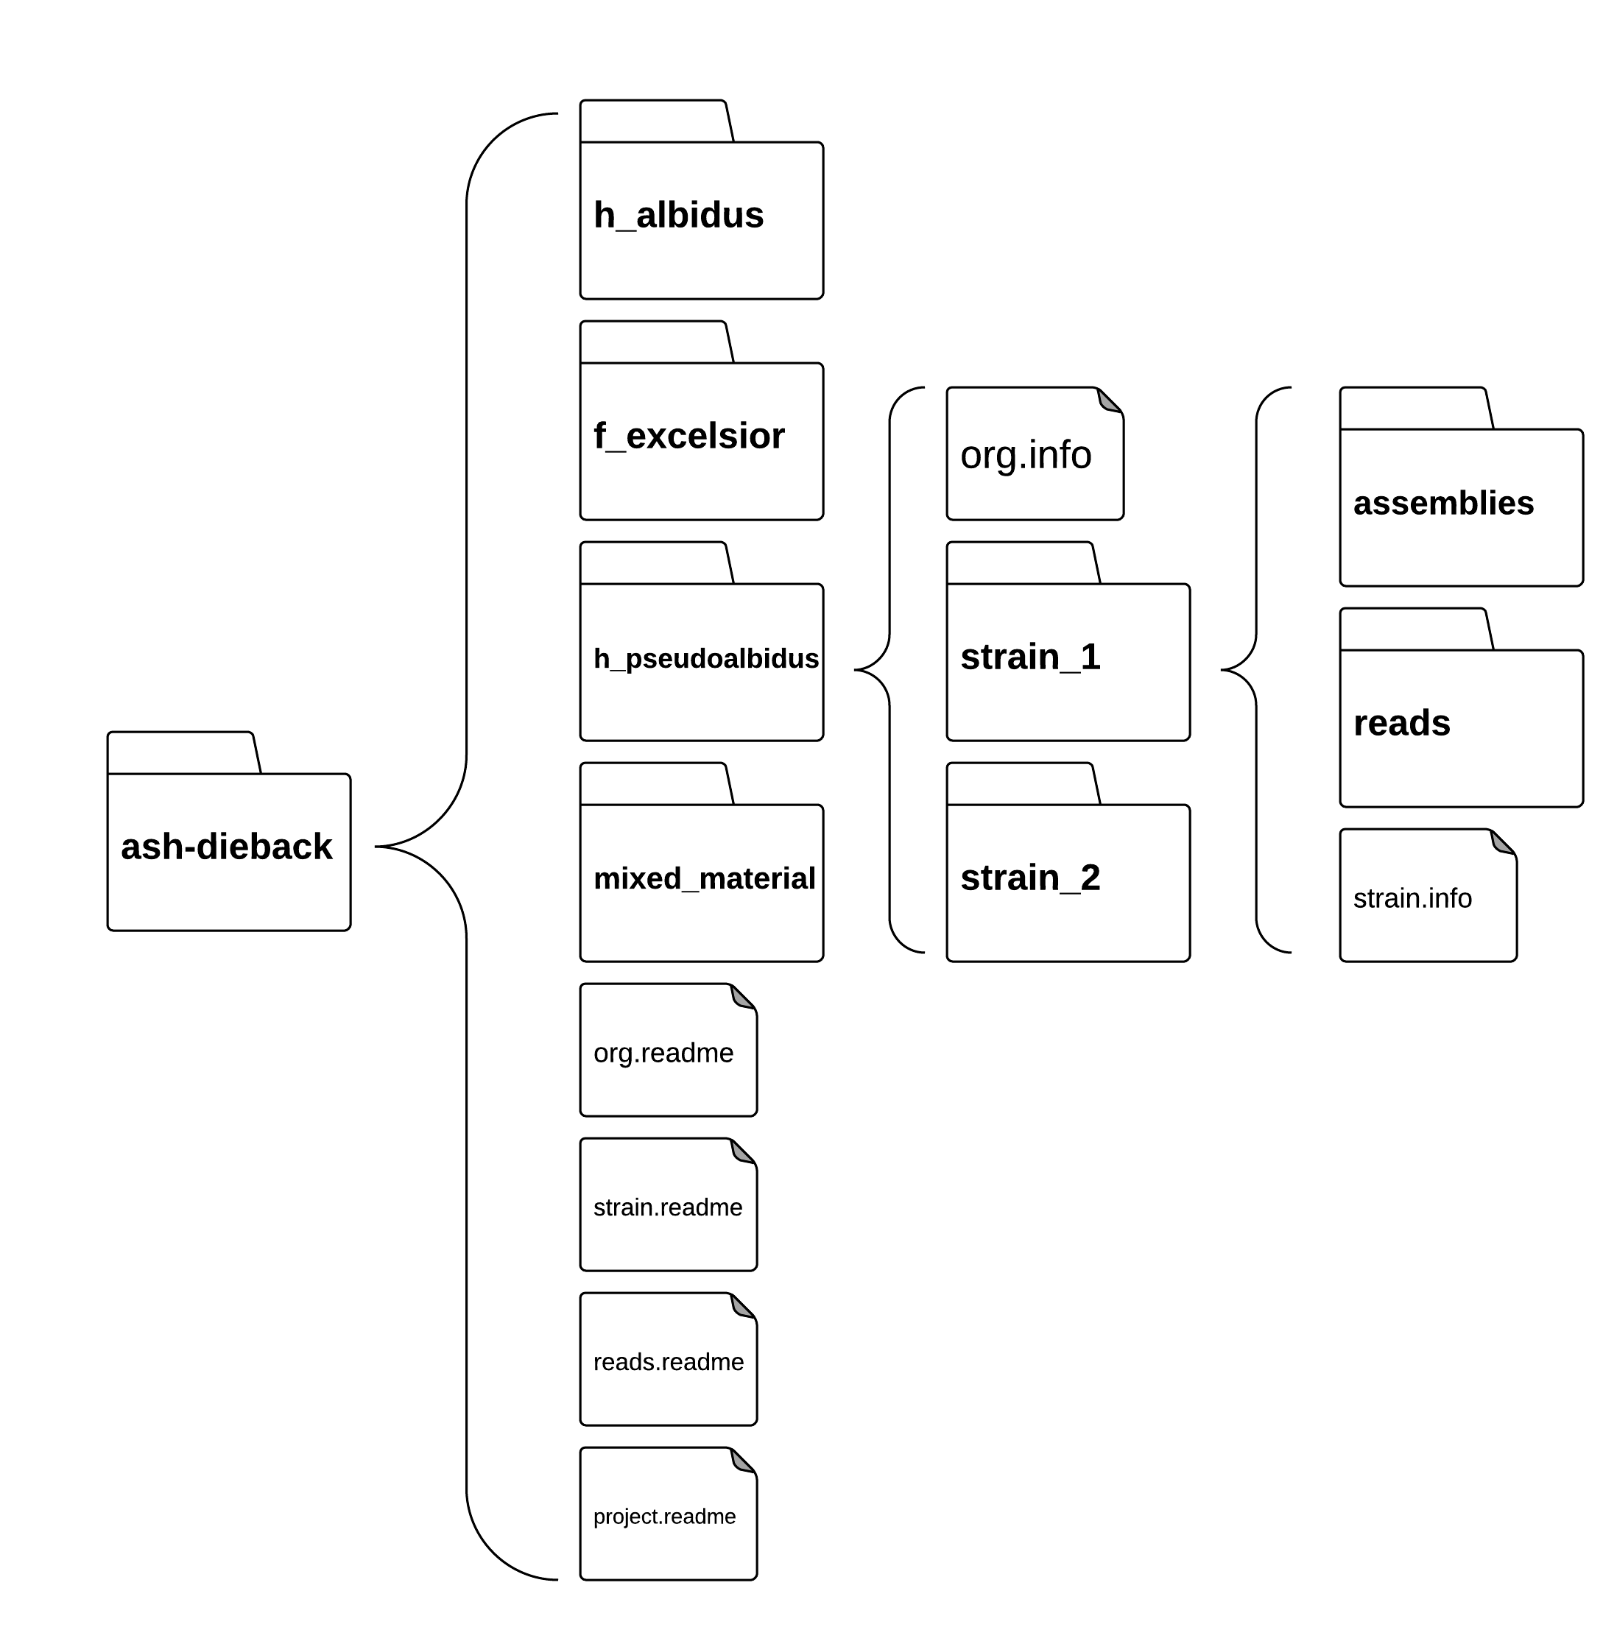
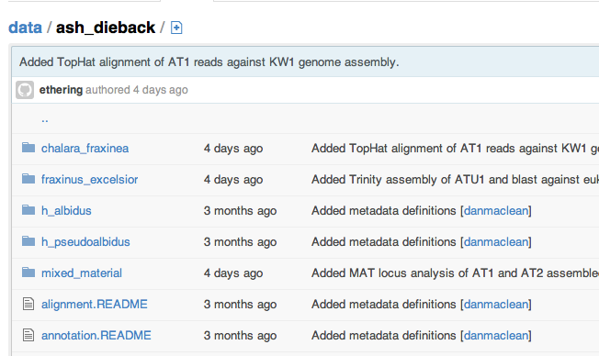
A simple ‘folder’ database
Structure of science inhibits sharing
https://github.com/ash-dieback-crowdsource/data
Notes:
This is the repo itself,
Basically just as directory structure – semantically organized so each dataset and its meta data has a fairly natural place to go.
To find anything its possible to just click through the higher level categories, like species down through strain to the different datasets.
At each level we have these metadata files that explain what is in the folder and how it was generated. It’s a functional, basic just enough sort of database that is good enough to get us going. We don’t ever intend that this is a replacement for databases of record like SRA, we fully expect that all the data in here that can be pushed to the major DB’s will be.

Slide 20
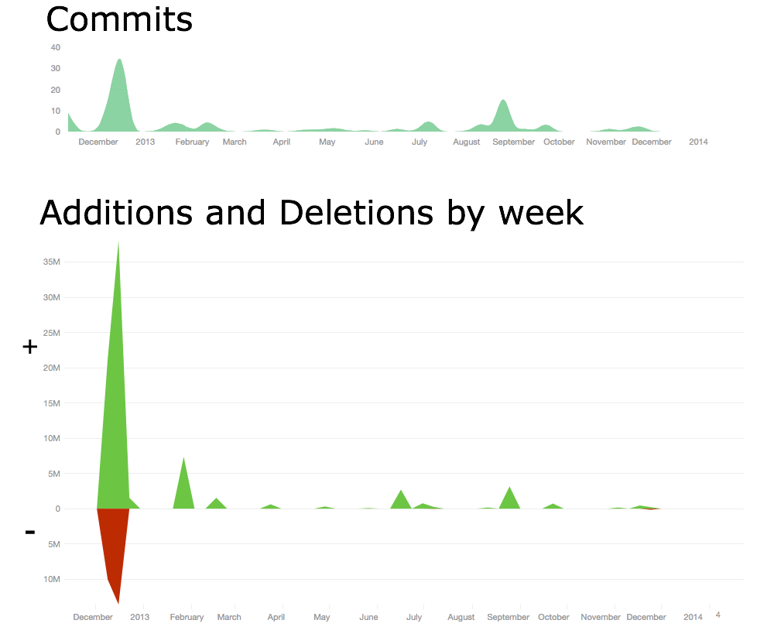
A THRIVING COMMUNITY
Crowdsourcing stimulates involvement
http://dx.doi.org/10.6084/m9.figshare.1005000
Notes:
We had a great start and its continued to draw interest. We stimulated a lot of involvement.
This top figure shows the commits, that is uploads, to the database over the first year. We got over 170 different contributions in this period, from at least 43 members. That’s a good size community from nothing.
The amount of analyses is great too, its quite hard to quantify analysis per se, but a rough guess is the number of lines of stuff added to the database. This peak of additions represents over 35 million new lines added. That figure doesn’t include raw data, raw reads and such, just the derived analysis output.
As you can see we’ve had multiple periods of large contributions over the year which has resulted in 37 separate blog posts about analyses from
So we managed to generate a really significant community in a very short time.

Slide 21
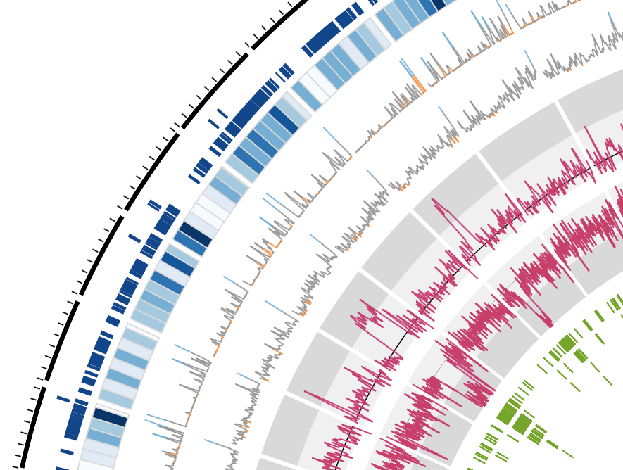
CROWDSOURCING GETS RESULTS
A repeat-rich genome
Bernardo Clavijo,
Manuel Corpas,
Matt Clark,
David Swarbreck
- TGAC
http://dx.doi.org/10.6084/m9.figshare.791640
Notes:
The analyses are going well,
We’ve been able to push quite far through crowdsourcing analyses and are starting to build up quite a good story about our pathogen.
TGAC in Norwich provided us with DNA sequence and a first draft assembly, which is what we see here. Contigs are arranged around the outside of the circle with gene densities in blue.
The green inner track is repeat sequences and the two pink tracks are back aligned read coverage and sequence GC content.
We’ve seen from this assembly that the structure of the genome is very interesting, we get these regions where GC content plummets and coverage and repeat sequence shoots up suggesting that the genome is a non typical reduced pathogen genome in which there are many AT-rich, repeat dense islands scattered throughout.

Slide 22
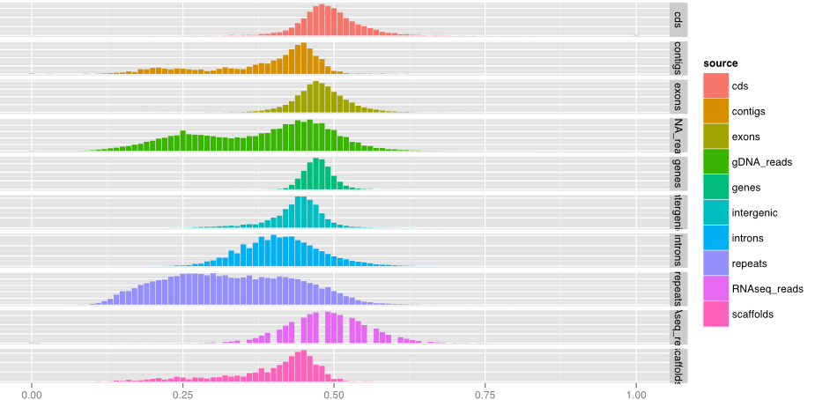
H.pseudoalbidus genome
Genome has AT-rich repeat structure
http://dx.doi.org/10.6084/m9.figshare.706771
Notes:
Finer grained analysis revealed that cod- ing features and Illumina RNA-seq reads are not AT-rich and that this is a property of repeat and intron features.
Together these analyses suggest numerous small collapsed regions in the assembly, an artefact like this can easily be corrected with the inclusion of longer reads

Slide 23
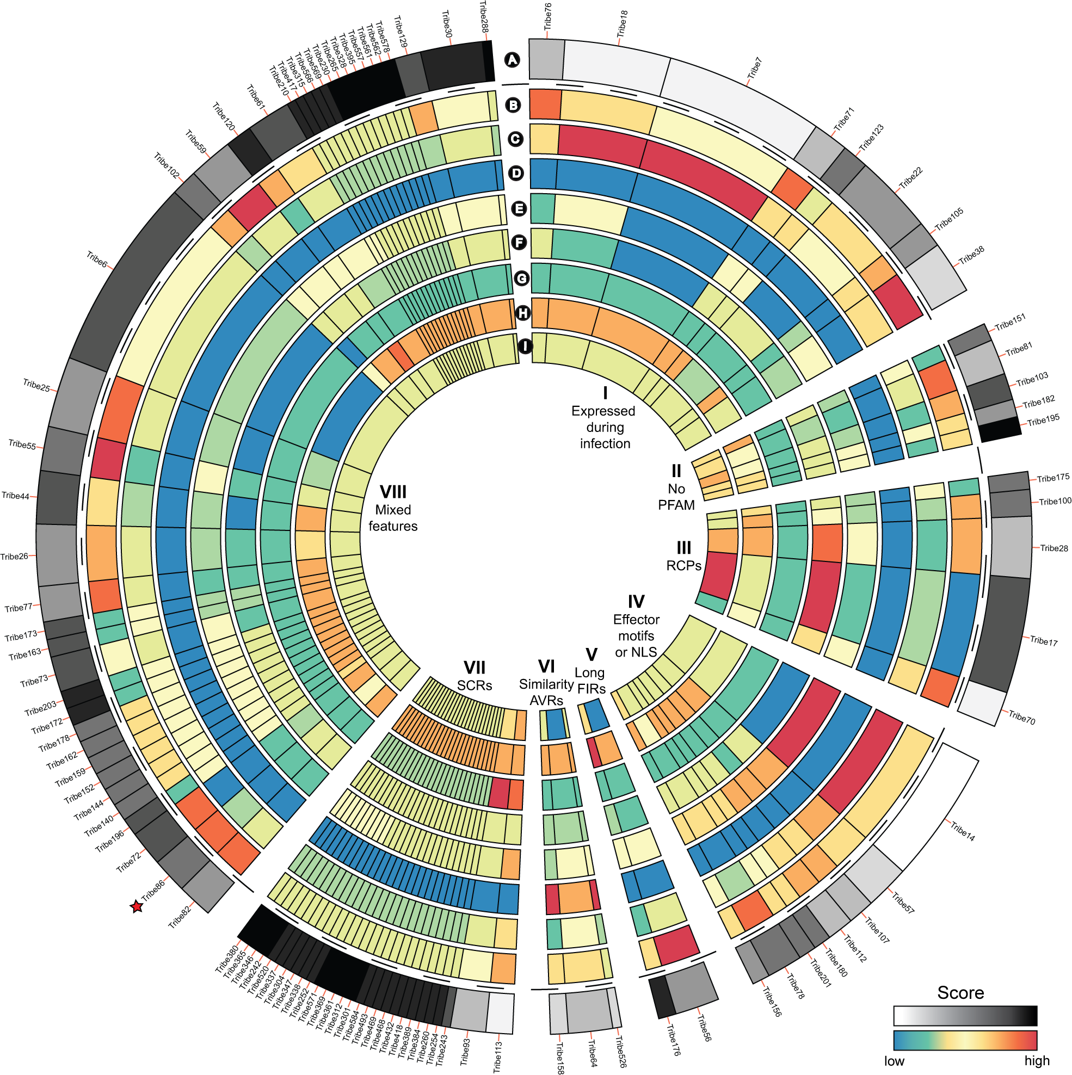
Identifying effector candidates
Diane Saunders
- JIC
http://dx.doi.org/10.6084/m9.figshare.1005005
Notes:
We also examined predicted proteome of H.pseudoalbidus KW1 for potential secreted proteins
We then clustered all proteins based on sequence similarity using OrthoMCL to create these tribes, the groups you see in the diagram, we annotated the protein tribes for known effector features
WE see a few common groups like those expressed during infection, those with common effector motifs, etc. And with this we identified a repertoire of effector candidates.

Slide 24
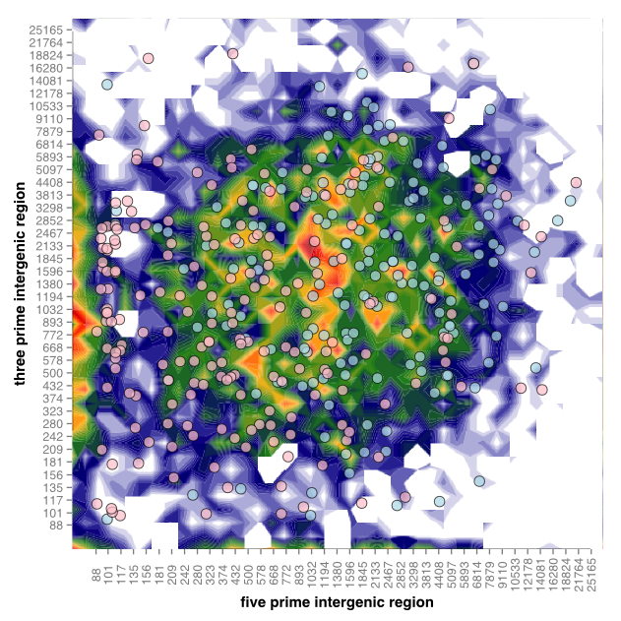
A ONE SPEED GENOME
Diane Saunders
Kentaro Yoshida
http://dx.doi.org/10.6084/m9.figshare.1005006
Notes:
We also got a good look at whether genes encoding secreted proteins are in gene sparse or dense re- gions of the genome.
This figure plots the five prime flanking intergenic region of the gene against the three prime, the colour indicates frequency and the spots are genes red spots indicate genes for the individual secreted proteins.
The pattern we see is indicative of a single speed genome, with genes encoding secreted proteins dispersed evenly throughout a genome that has no obvious gene sparse or gene dense regions.

Slide 25
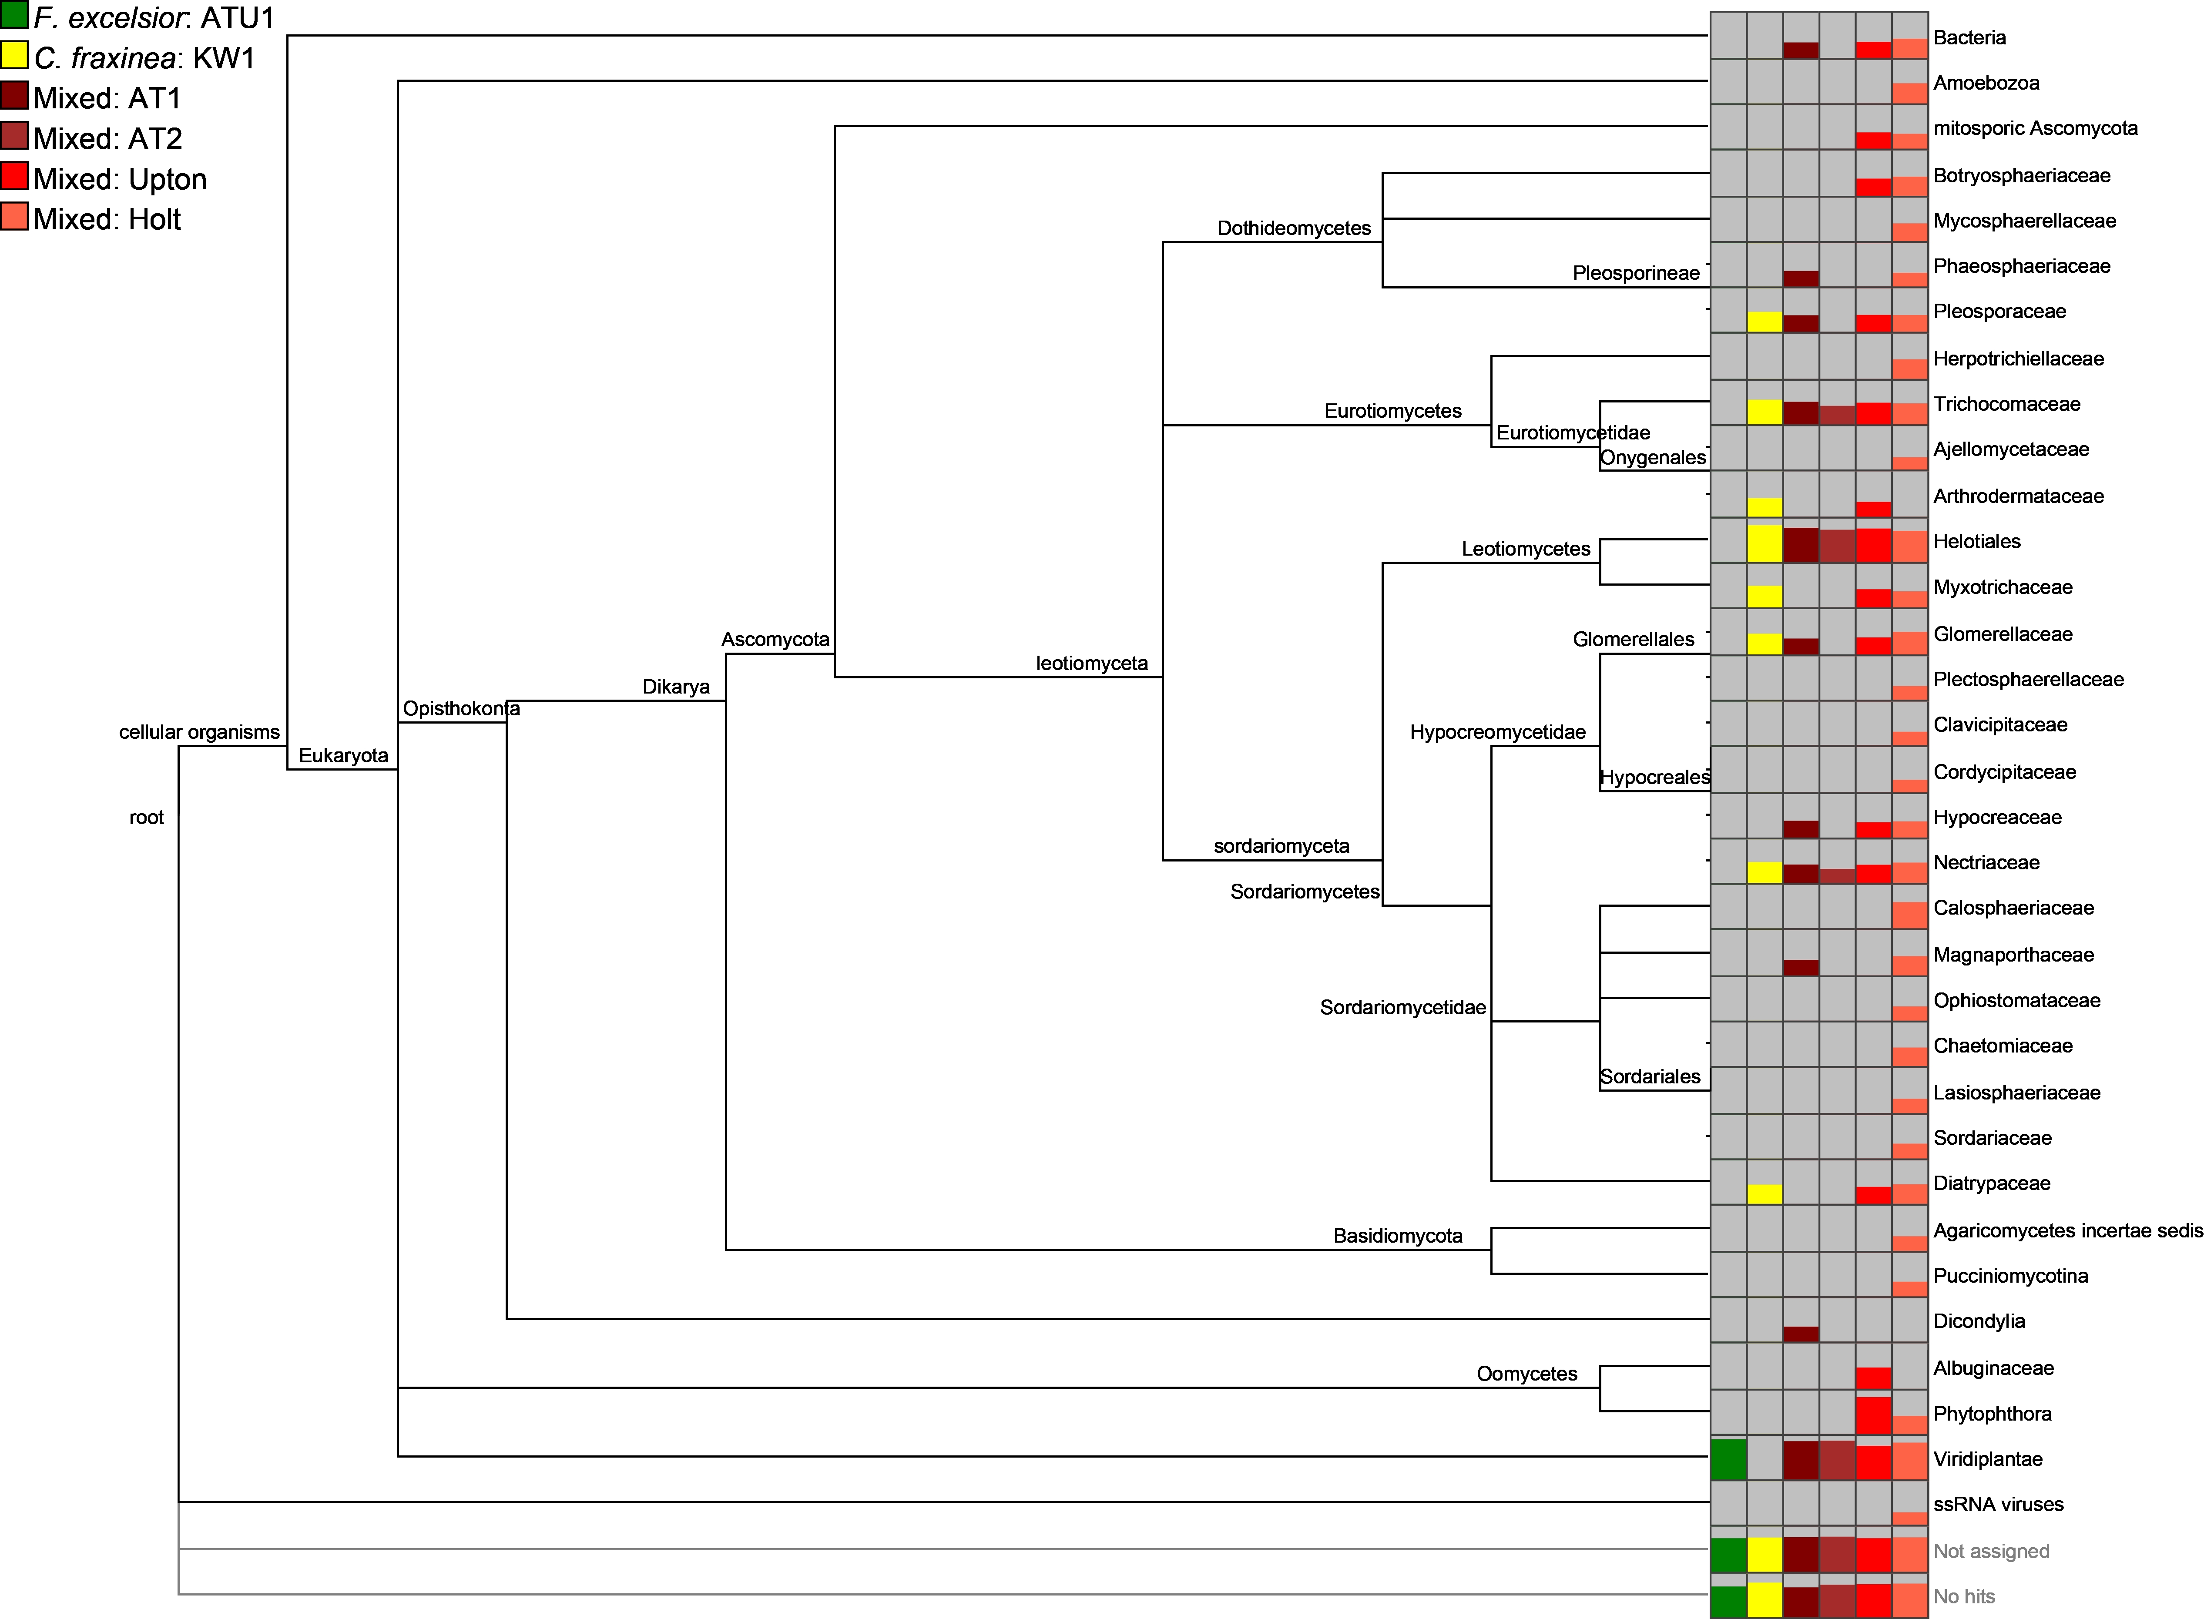
METAGENOMICS
Christine Sambles
David Studholme
- U of Exeter
http://dx.doi.org/10.6084/m9.figshare.807684
Notes:
We’ve also received metagenomic analysis of the mixed material samples on OADB. These showed us the range of organisms potentially co-habiting with the fungus, in particular we noticed Togninia
Species which has been observed in dead vascular tissue of declining ash tree branches in the US.

Slide 26
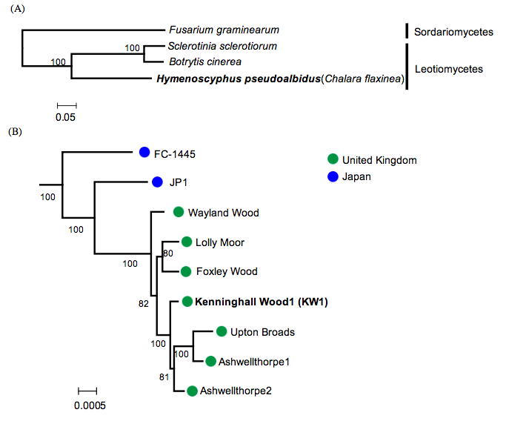
DIVERSITY IN THE UK POPULATION
Kentaro Yoshida
Tsuyoshi Hosoya
http://dx.doi.org/10.6084/m9.figshare.1005007
Notes:
We’ve had quite a few donations of strains from around the UK and the wider world now. We’ve been able to do SNP calls relative to the reference with these and show the diversity between these isolates
Japanese isolates were separated from a single common ancestor of European isolates, suggesting that Japanese isolates might be ancestral, very distantly. The japanese isolates also showed much greater genetic diversity and overall the tests on over 5000 genes suggest that the tested genes are unlikely to have been subjected to positive selection since the separation of the UK and Japanese isolates.

Slide 27
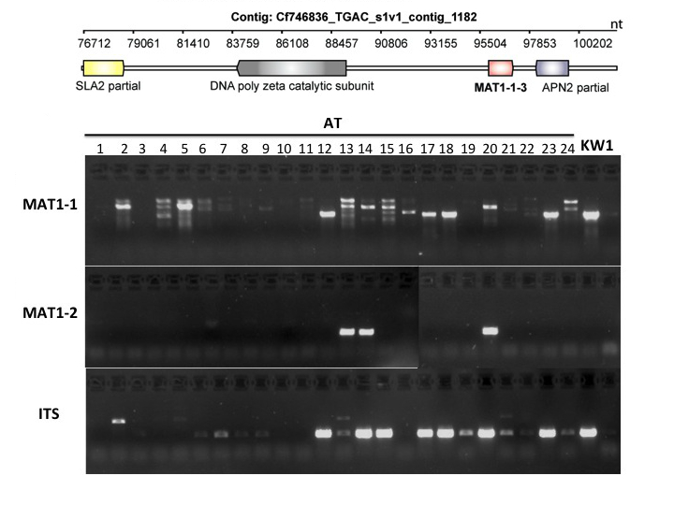
MORE THAN ONE MATING TYPE
Anne Edwards
Diane Saunders
-JIC
http://dx.doi.org/10.6084/m9.figshare.1005008
Notes:
We had analyses provided that used partial sequences of MAT loci, mating type loci from related species and used those to fully reconstruct the same in H.pseudoalbidus and then showed that different mating types were present in the UK and at a ratio that suggested sexual crossing had been going on for a while. Which in turn indicated the fungus had been in the country for longer than the first sightings.

Slide 28
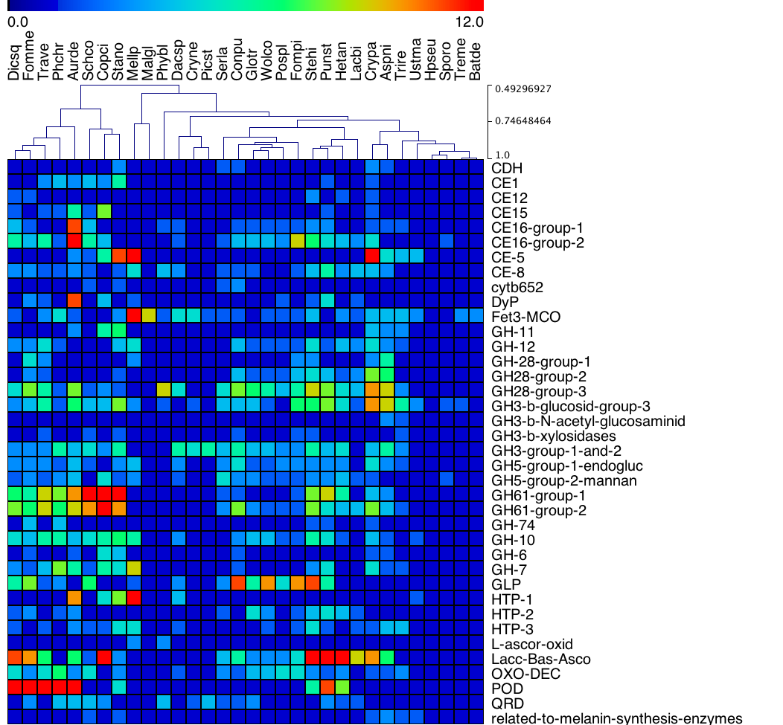
NOT A ROTTER
H.pseudoalbidus doesn’t have the genes for wood digestion
http://dx.doi.org/10.6084/m9.figshare.791635
Notes:
As it’s a tree pathogen we also inspected the genome for genes that are typically involved in lignin and cellulose degradation, the major components in wood.
The genome was compared with those from a load of basidiomycete wood rotters, and counts of typical degradation genes made, H.pseu pops up down at this end, with virtually none of the sorts of genes that are typically used in digesting wood, indicating that it gets into the tree without directly attacking the wood.

Slide 29
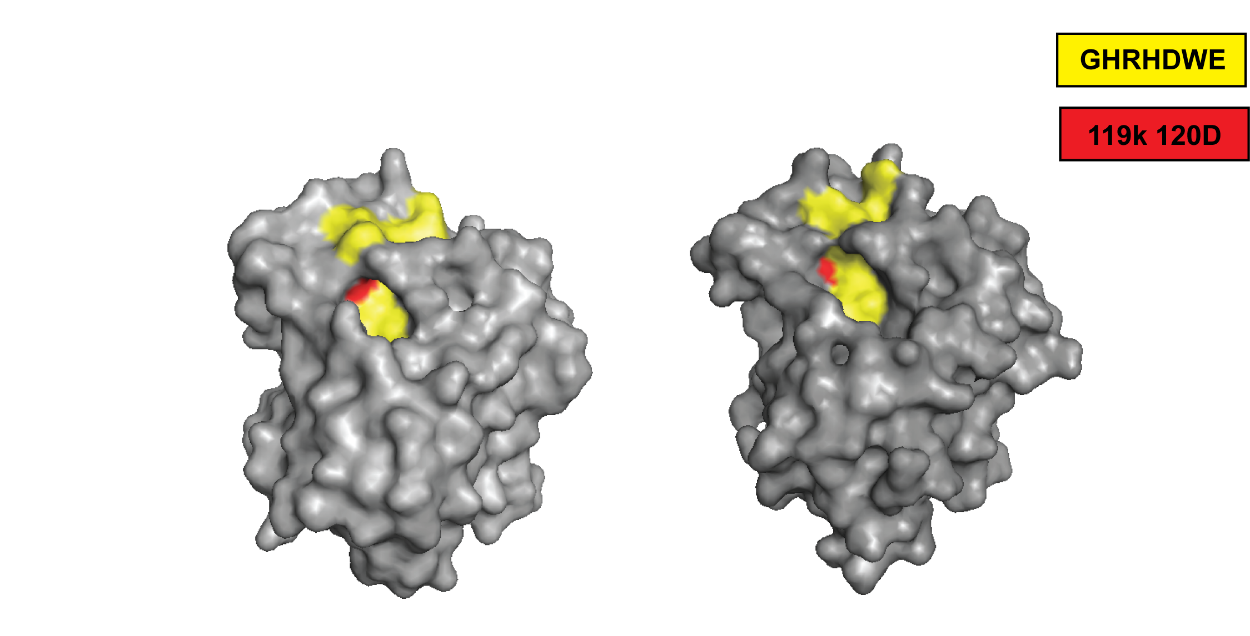
TOXINS ENCODED
Nep1-like protein in the genome
Suomeng Dong
H.pseudoalbidus hypothetical NLP
NLPpya 3GNU
http://dx.doi.org/10.6084/m9.figshare.1005010
Notes:
Suomeng collated seven fungal and oomycete Nep1-like protein (NLP) sequences from public databases and used these in a tblastn against the h.pseu transcript assemblies. He identified a transcript with high similarity to NLPs,
The protein sequence was then used for protein structure modelling, with the published NLPpya 3GNU as a template. This analysis shows that the predicted protein we identified carries all the key residues for NLP cytolytic function, these red ones here.

Slide 30
Open Science
Notes:
So the next thing I’d like to touch on is how we’ve been developing new tools and approaches for extending this open crowdsourcing approach, to extend the community to other scientists while still staying within these theme of open science

Slide 31
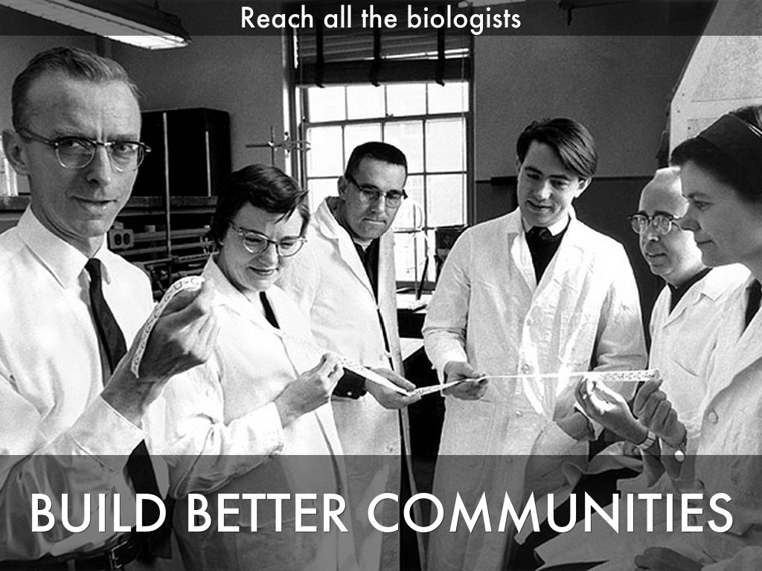
Photo by mars_discovery_district - Creative Commons Attribution-NonCommercial-ShareAlike License http://www.flickr.com/photos/17016583@N00
Created with Haiku Deck
Notes:
Getting bioinformaticians involved through github is fine.
But they have a habit of doing bioinformatics analysis and knowing less about the pathogen than they might
We realised that to really add value to our data then the important thing is to bring in biologists, who know all about the pathogen and host biology to get involved and liberate the genomics data and expertise to them and get the insights back from them.
The first thing we did was put together the basic databases with the right query interface that will help the biologist find what they are looking for from their bit of sequence, their gene or protein function or their named gene and let them start to interrogate the data that was being created.
Crowdsourcing, and in particular wide ranging, comprehensive and hopefully sustainable crowdsourcing is dependent on the community that you can build. So the whole task generalises to one of how you actually build better biology/bioinformatics communities and how you incentivise that.

Slide 32
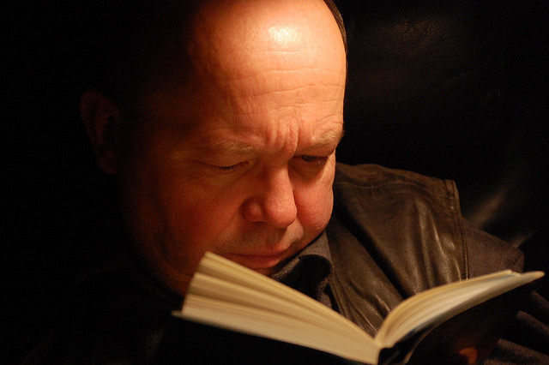
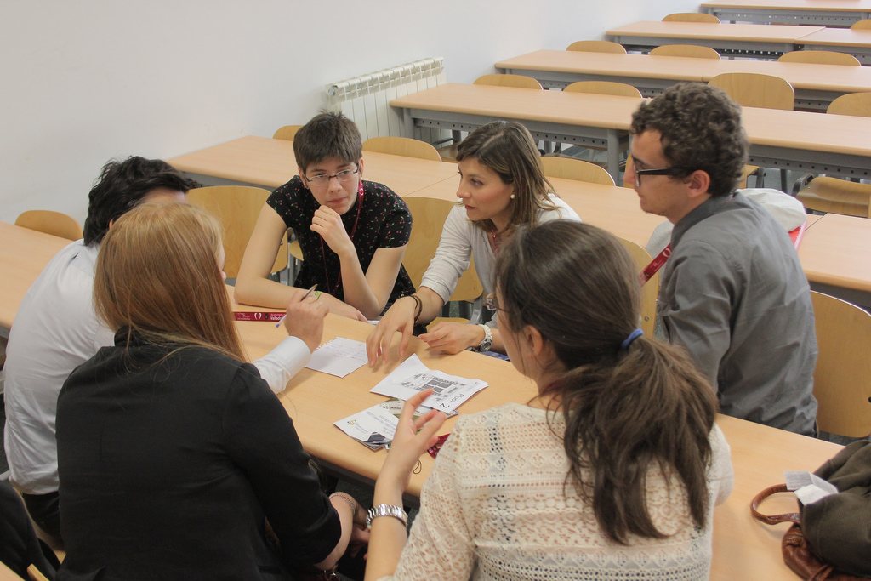
CROWDSOURCING GENOME BROWSER
Reading by JanH on flickr, licensed under CC-BY-NC-SA 2.0
Discussion by Bestorg on flickr, licensed under CC-BY-NC 2.0
Notes:
And we’re trying this through new tools and interfaces.
We’ve put together something we’re calling a crowdsourcing genome-browser. Im sure that you’re familiar with the idea of a genome browser.
Our crowdsourcing browser relates to that in the same way that this guy reading his book relates to these people having a discussion. Our new crowdsourcing browser allows us to take in things like annotations, and experimental information straight into the repository while providing functionality like BLAST. The info is recorded piecemeal and reflected back to the other users of the tool directly.

Slide 33

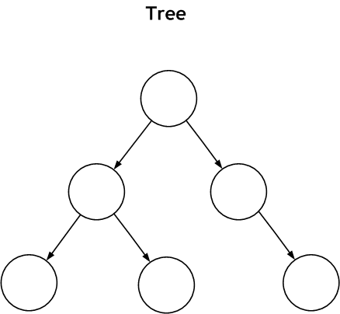
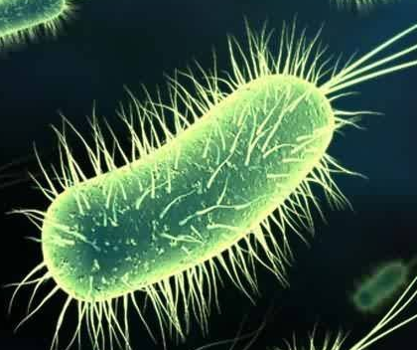
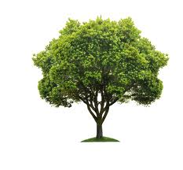
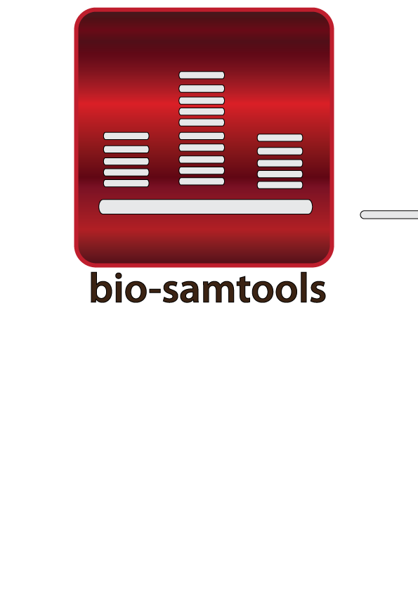
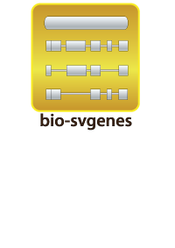
gee-fu – crowdsourcing genome browser
assemblies
annotations
https://github.com/wookoouk/gee_fu
doi:10.1093/bioinformatics/btr442
https://geefu.oadb.tsl.ac.uk
doi:10.1186/1751-0473-7-6
doi:10.1093/bioinformatics/btt294
Notes:
We’ve adapted an old lab tool that we used for collaborative annotation internally. Called Gee Fu and has genomic features as its main model and allows multiple organisms and multiple assemblies per organism to be called up and analysed, instead of just one.
It runs on our bio-samtools and svgenes gems to render bam data and features, and integrates other open source software like bio-dalliance as a portable viewport.

Slide 34
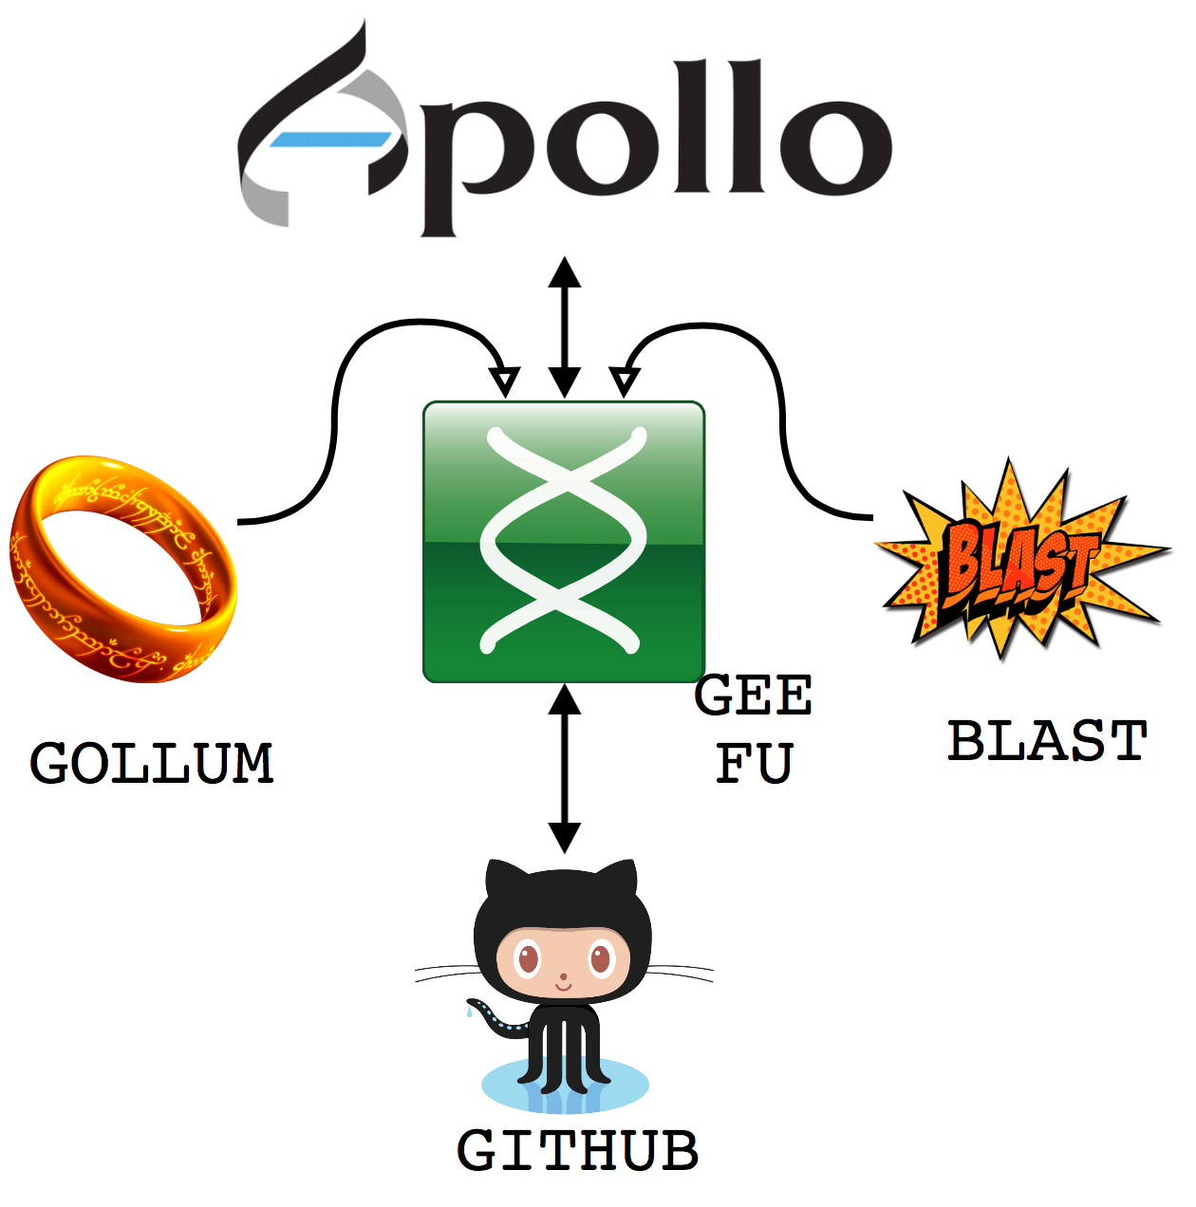

Notes:
This is the analysis part of our stack. Its based on common open source tools, the inimitable WebApollo being the major genome browser style component, GOLLUM is a git based wiki engine, every object, not just features can be annotated through this wiki, and we also used sequence-server, a ruby gem that implements a BLAST server for sequence based searches. All these are tied together through Gee fu, which is a piece of middleware that acts as an integration layer between other tools
it acts as the dispatch engine for data to the GMOD project web-Apollo genome annotation browser, as a feature linking engine for the wiki and as the sequence store for a BLAST server.
It coordinates automatic exchange and concurrency of data between the apps and the github repo, making sure that contributions from these other tools are tracked into the github repo
It provides a restful interface to the repo data and still acts as a feature and meta data editor in its own right.

Slide 35
gee fu – in browser annotation
Notes:
Its major function is annotation, the tool provides ways of directly editing and annotating gene models as you browse, and propogates all the edits directly to the data base so all other users can see immediately

Slide 36
gee fu – in browser analysis
Notes:
It also allows sequence searches of the provided data too, and fully cross links this back to the annotations and reports Kind of like a “build your own NCBI”, but restricted to a new and growing set of information for ash dieback

Slide 37
Fraxinus
Notes:
Extending the crowd sourcing idea, it seemed natural to try and get the public involved in our quest. This is what we did late last year with our Fraxinus project

Slide 38
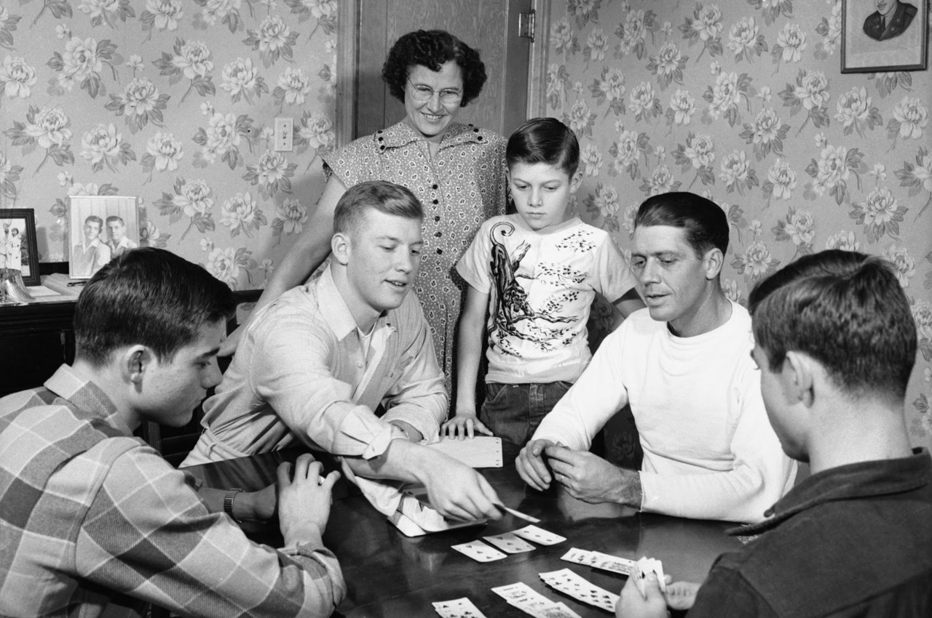
Humans love games
Notes:
A high profile pathogen like this, particularly in the UK where there is a deep social and cultural connection to the countryside and particularly the woodland suggests that there would be a great deal of public interest in what we’re doing to sort out this problem.
Scientists are terribly outweighed in numbers by non-scientists, people with interest in these issues, who are motivated to use their spare (and not just professional or work time) to try and make a difference in the world.
So we’ve started crowd-sourcing through citizen science projects.
And we took the opportunity to use people power to do analysis of genetic variants that would show up in our sequence data
In many of the variants we want to examine, the computer programs make errors that a human being would not.
High throughput algorithms are error prone in some key parts of assemblies and genomes, like INDELs, or at assembly ends or repeat rich regions.
Scientists correct the alignments that underly SNP calls by eye all the time: So we built a game to allow Non scientists to do this for us and put the SNPs the computer is likely to have got wrong into it.

Slide 39

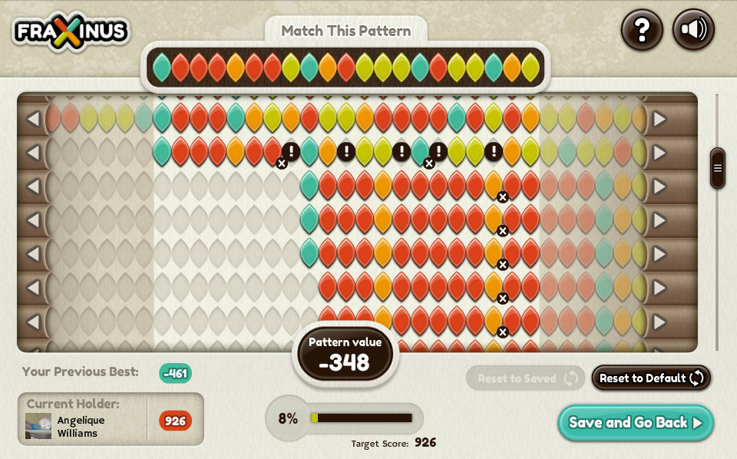

Notes:
So the game we produced is called Fraxinus, it’s a FLASH only facebook game designed by myself and the BAFTA nominated game company Team Cooper in Sheffield
This is the main game screen of Fraxinus,
Along the top we have Target Pattern, from one of our references. Targets are pre-selected to be the sites the algorithms make a mess in.
The rest of the coloured rows are reads from DNA sequencing experiments.
The player can Shift, insert and delete nucleotides to make best alignement
Score for matches, score deducted for mismatches and creating and extending gaps.
Once player has maximum score they think they can get, they can claim the pattern for themselves and get points for that

Slide 40
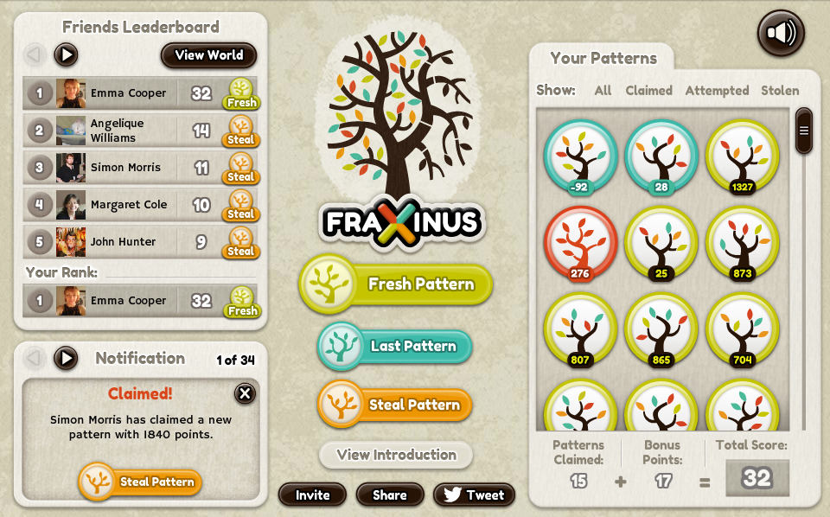
Notes:
Extra Value comes from being able to play against your facebook friends. The game allows you to compete directly over patterns. The box on the right contains the patterns you’ve won, but by hitting the steal patterns button you have the opportunity to take a pattern from a friend.
All you have to do is score one point more.
This is valuable to us, because then the patterns get analysed more deeply since many sets of eyes and brains look at each.
The game incentivises this behaviour by awarding more points for stealing than taking a fresh pattern. Thus the winning strategy requires the player to replicate an analysis.
The game takes the colour information from the alignment and returns a SAM format file to a MySQL database on our server along with the players FaceBook name.
We can take this data and put it straight into analysis pipelines.
So playing the game is doing real science. The results the players give us go straight back into our public databases to be used in further analyses.

Slide 41
People play Fraxinus
In 6 months: 55K visits from ~25K players
Average visit ~23 minutes
2 years & 2 months - continuous game play
10K patterns – received 154K solutions
2000 players – 70% solutions
Notes:
We had some interest in this from the media, it was featured on the main BBC radio news programmes and the national news on TV.
As a consequence we have had a very fast and very high response.
18 thousand unique players in 126 different countries
With more than 100 playing simultaneously
Thrillingly, people have been so keen to play the game, they’ve been trying to ‘game’ the system. The early top player was a person called ‘Ash Dieback’ who hit 1034 points in under a week you get one point for doing a puzzle (note we didn’t design enough space for a four figure score).
This player adopted a very laissez-faire ‘skimming’ strategy in which they played many games, improving the random alignments just a bit. This contributed to very wide coverage of our data and we’ve started to reach the point where some of the data sets aren’t improving alignment scores any more and we can retire them from the game.

Slide 42
People play Fraxinus
1000
Visits per day
10
40
Avg visit duration
per visit
per day
(minutes)
30
20
10
October
January
April
Notes:
The first big question then is did anyone turn up?
How many people came to play?
Here we see a timeline of visits per day to the site from its launch in August last year. This is a log scale, and even after the initial excitement has died down we get between 50 and 100 visits a day.
In total this is 59,700 visits, from 25 000 different addreses.
! And how long did they stayfor?
This bottom one is a plot of average visit durartion per day – 23 minutes on average, if anything this is increasing as time goes on.

Slide 43
People play Fraxinus on Wednesday, at Teatime
Visit Frequency
Sun
Mon
Tue
Wed
Thur
Fri
Sat
Visit Frequency
00:00h
12:00h
23:00h
Notes:
When did they come?
Cam mostly from UK, 38000 of those visits the second and third countries are the US and canada and in total we get interest from 130 countries

Slide 44
We have an engaged community
Duration of visits by
player category
Number of visits by player category
40
new players
visits
mins
20
returning players
October
January
April
new
players
returning
players
Notes:
This hasn’t been from casual players, a hardcore of returning players, who seem to spend a long time on this.
Our media events and press releases, shown as red lines on this graph, increase the number of casual visits but have less of an effect on the number of returning players who give fairly constant effort. The community we have generated is fairly constant over time.
The amount of time contributed by returning players is very large, about 30 mins each visit. Some people play for ages!
In total, the amount of continuous game play so far has been 2 years and 2 months, that’s continuous, not 9-5 equivalent. That’s 316 60 hr postdoc weeks. Or 6 years of postdoc time.

Slide 45
We have an engaged community
Player Number
October
January
April
Notes:
Overall, the majority of play has been coming from just a small group of players.
This figure shows the dates of visits of 22 different players, each line represents a player, each dot a date they played. Each of these players has been on our site, a thousand times.
And as you can see, they’ve mostly visited constantly across the entire time the game has been available.
So we’ve got a community of really commited, really engaged players. And that’s an interesting point about citizen science, you cast a wide net and you find the three people in a thousand who might have an interest in what you’re doing and you can hook them. It isn’t about getting absolutely everyone to contribute in the long run.

Slide 46
~35 % of puzzles arranged differently to machine
Puzzles different to computer
6000
4000
2000
0 %
50 %
100 %
Notes:
So has our community really contributed anything useful? The game was designed to
Well, we’ve analysed the results from our first data set, which contained 10000 puzzles representing just over a thousand variants. We had to split a lot of the variant sites up into separate puzzles because of the large amount of screen space that the reads take up, we could only afford to have about 20 reads on screen and still keep the player sane, so we divided the puzzles up into subsets and there were 10,000 of those.
This graph shows that in about 6500 of those the player aligned no different to the machine, they couldn’t do anything differently. But in almost all the remaining 35 % then the player aligned every read differently and therefore added value.
And each dataset got looked at many times. Our ten thousand patterns received over 154,000 solutions, so we got more than 15 plays of each data set, which is a really good replication rate, even for a statistician.

Slide 47
Players better at INDELs by far
 | SNP | INDEL | Total
Present in first data set | 1002 | 160 | 1162
Reads with better than 1 % identity score improvement | 2.7% | 15% | 4.4%
Notes:
When all those different mixed up puzzles are boiled down back to their original variant positions, we can see the overall added value of the players efforts to the science.
In the 1002 SNPs present in the data set we see that players managed to align just 2.7 % of the reads better than the machine. I should point out we always knew we would have many more SNPs than indels and that any benefits we would get from SNPs would be marginal.
We hope we would do a lot better on indels, and indeed we did. 15 % of indels called by the machine could be improved by the players.
And this is all of the payoff, scientifically. This is inline with other citizen science games like foldit.
The trick for the future of Fraxinus, is to play to the crowds strength, to maximise the number of indels we are putting in there, and also to see what it is about these indels that means they were harder to do. While it seems like an edge case framed in these terms, especially given the manpower we seem to have thrown at it, these numbers only go to show the difficulty of the alignment problem informatically. 15% improvement is quite large in algorithm design terms, especially for a problem considered solved like variant calling. If we can somehow also capture what the players are doing with these indels then we have grounds for great improvement in our automated methods.

Slide 48
Training
Notes:
I’d like to mention briefly some of the changes we’ll be bringing about in the training that we do.

Slide 49

“Qui docent lanistam?”
Who trains the trainers?
Software Carpentry
Educational Psychology
Instructional Design
Notes:
Primarily we’ll be paying a lot more attention to the way that we train. We’ve very much been doing this ad hoc, as trainers we don’t have any formal background so we’ve decided to address this by getting our selves trained to do the job better.
We’ve got involved with the good people at software carpentry, a branch of the mozilla foundation that produces software like the firefox web browser, that aims to teach scientists who program how to teach programming to scientists who don’t.
They have a focus on methods rooted in educational research and we’ll be learning some educational psychology, that is, learning how students learn and what motivates them and also we’ll be learning about instructional design, how to make our training courses better for the learner, so that we can maximise the amount that is learned.

Slide 50
Evolutionary
Models
Notes:
Finally then, I’d like to talk about a project that’s just got started, a brand new venture for us, that is very much pointing the way we hope to go in the bioinformatics team. We’ve started looking at modeling scenarios in plant pathogen genomics to understand rapid evolution and the host pathogen arms race.

Slide 51
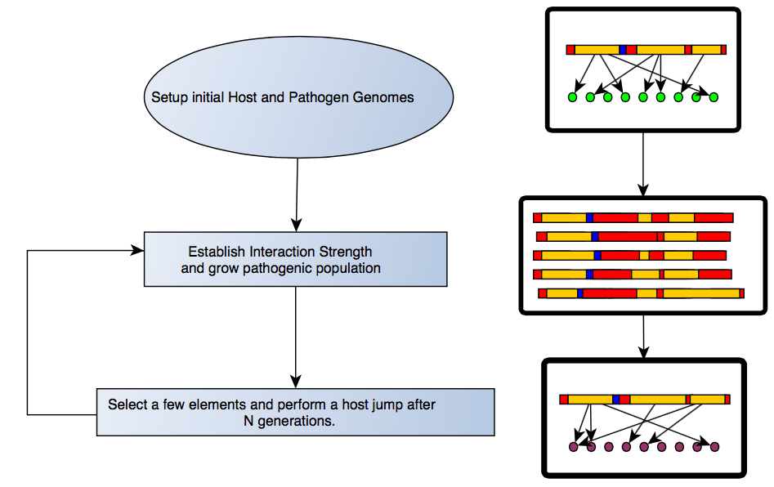
A model for studying rapid evolution in pathosystems
Notes:
This work is Carlos’ project and the first thing done with this is to set up a general model for studying rapid evolution in pathosystem . Its simple enough conceptually,
We start of by creating genomes, which are basically just collections of familiar genome like objects. Specifically we have two sorts of genome, a pathogen, that contains either effectors, or repeats or non-effector genes. We also make host genomes which have only R genes in them.
We set up some interaction rules between the effectors and the R genes, such that effectors have R genes they will beat or R genes will have effectors they can stop
Then we make a population of those pathogens and put them through cycles of selection for a while.
And its there that we can start to do tests and make predictions.

Slide 52
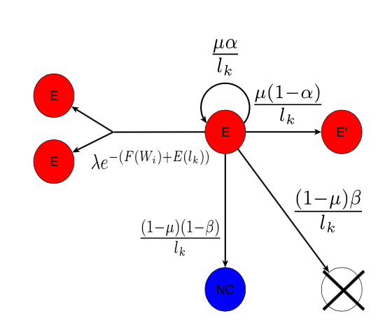
Objects in the genome can “mutate”
Notes:
Within the genomes of the pathogen, we can allow the different objects to mutate. Here is an example of what an effector can do.
So starting with an effector, at any given generation it can either get duplicated into two equal effectors.
Or it can get converted into a non-effector gene,
It can get converted into another effector or it can get deleted.
This self loop is the case where nothing happens to the effector, essentially it gets converted into itself, and this is the thing that happens with greatest probability.
Each of the bits of maths here represents only the sum for working out the probability that this will happen at each generation.

Slide 53
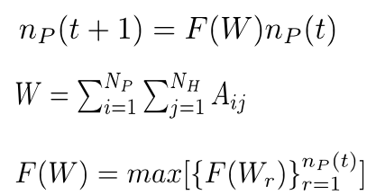
Changes occur in little steps
(previous time)
F(W) = modification rules
t = timepoint
“The population of genomes at 1h = each genome at 0h modified by the rules”,
“The population of genomes at 2h = each genome at 1h modified by the rules”,
“The population at 3h … etc”,
“A starting population, 0, is chosen”
Notes:
The models we are developing are discrete models, that is to say they’re like clockwork mechanisms, everything happens in discrete steps of time.
We have some set of rules that we apply to the population of genomes at each timepoint t, this set of rules is called F(w)
So in our models the makeup of the population of genomes at the next time point is the set of rules applied to the makeup of the population in the previous step. This is how we represent this in maths, but in english its equivalent to saying: … …
With the implication that a starting population is chosen somehow.

Slide 54
The value of “W-ness” is computed for each genome
1
2
3
A
 | 1 | 2 | 3
a | 0 | 1 | 0
b | 1 | 0 | 0
c | 1 | 1 | 1
d | 0 | 0 | 1
a
b
c
d
e
f
g
h
i
Value from matrix A
Effector
R gene
1 | a | 1
1 | d | 1
1 | i | 1
2 | b | 1
2 | e | 1
2 | f | 1
3 | g | 1
“W = The added up values from A”
W represents the interaction strength between the host and pathogen
Notes:
For each genome in the population we have to compute a value that tells us about that genome and how its interacting with the host. This we call W. Before we start we decide on a set of rules for the effectors and R genes we’ve created, this we see in this matrix we call A.
In this example, we have effectors 1 to 3 and R genes a – i and for each possible pair we can decide whether they can interact or not.
Then we do this bit of maths, which basically means that W is the added up values from the table A. So for Effector 1 and rgene a we get a score of 1, etc. so that the value for the interaction overall is 7 in this example.

Slide 55
Modify the population
“Use W in a selective step, which maximises the reproductive ability of the individuals in the population.”
“Re-apply procedure over and over for N time steps”
Notes:
Then we can use that and put it into our set of rules, F(W) to create a selective step, thiswill be a function that expresses the reproductive ability best, we’re testing out appropriate functions right now.
So these three lines represent the class of model we’ve built and can go on to use and we can go on to answer lots of questions

Slide 56
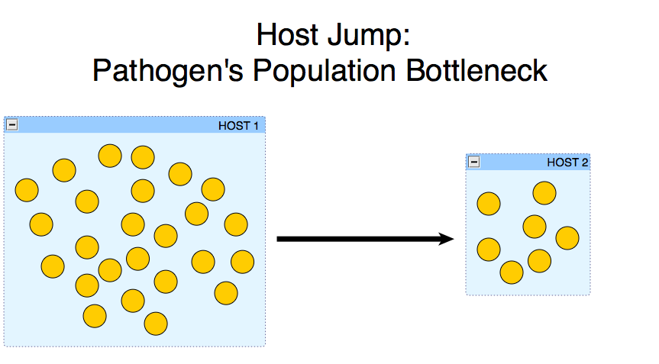
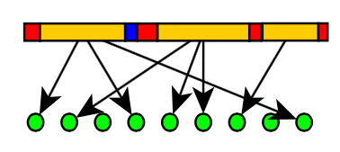
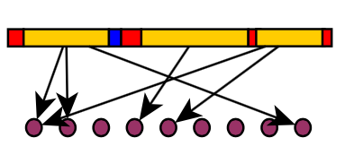
Examining host jumps
Notes:
We can easily apply this model to looking at things like the host jump scenario… what happens if we arbitrarily switch the host genome, in particular we’ll be looking at what happens to the lengths of the genomes.
But we will also look at the effect of R gene number on host evolution. What happens if you vary the number of R genes to a finely balanced system? How long before the resistance is lost? We can add in all sorts of complexity and different dimensions to our base model and we can start to get a handle on these thorny questions.

Slide 57







Acknowledgements
Martin Page
Graham Etherington
Shyam Rallapalli
Carlos Lugo
Sophien Kamoun
Kentaro Yoshida
Diane Saunders
Suomeng Dong
Joe Win
Daniel Bunting
David Studholme
Christine Sambles
Team Cooper
Thomas Down
everyone on oadb.tsl.ac.uk
All players of Fraxinus
Allan Downie
Anne Edwards
Mario Caccamo
Bernado Clavijo
David Swarbreck
Manuel Corpas
Notes:
So finally here are just a few acknowledgements, not everyone we’ve worked with at TSL
This is a list of people involved with the work I concentrated on in this talk.

Slide 58
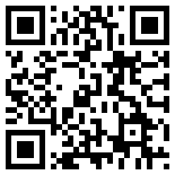

More Info
http://tinyurl.com/dan-maclean
http://biorxiv.org/content/early/2014/04/25/004564

